Slide 1
Medical Insurance Coverage
Graphical Analysis of the Expansion of Coverage (2010-2015) versus Medicare Cost Per Beneficiary et al. and their correlations with Potentially Preventable Deaths Among the Five Leading Causes of Death — United States, 2010 to 2016
Shuzhen Yu, Kyle Conniff, Tim Look

Slide 2
The PPACA, Expansion of Coverage and Healthcare Costs
The two main focuses of the PPACA as reported to us in 2010 was to:
Expand Coverage
Contain Costs
Well the expansion of coverage is evident in the following Data Sets, but what about the containment of cost?
What else is significant about these analyses?

Slide 3
1. Medicare Hospital Spending by Claim from Data.gov
The data displayed here show average spending levels during hospitals Medicare Spending per Beneficiary (MSPB) episodes.
This dataset provides the pre-risk-adjusted values to help the public understand the MSPB Measure and its composition.

Slide 4
2.Health Insurance Coverage rates before and after the Affordable Care Act from kaggle.com
This dataset provides health insurance coverage data for each state and the nation as a whole, including variables such as the uninsured rates before and after Obamacare, estimates of individuals covered by employer and marketplace healthcare plans, and enrollment in Medicare and Medicaid programs.

Slide 5
3. NCHS - Potentially Excess Deaths from the Five Leading Causes of Death from data.gov
* Potentially Excess Deaths from the Five Leading Causes of Death in Nonmetropolitan and Metropolitan Areas, United States, 2005-2015.
* Heart disease , Cancer , Unintentional injury , Chronic lower respiratory disease , Stroke are the five leading causes of death.
* Benchmarks are based on the three States with the lowest age and cause-specific mortality rates. We used “Benchmarks 2010 Fixed” as a fixed benchmark based on the best performing States in 2010.
* Potentially excess deaths for each State are calculated by subtracting deaths at the benchmark rates (expected deaths) from observed deaths.

Slide 6
Introduction:
# The Affordable Care Act (ACA) or nicknamed Obamacare, is signed into law by President Barak Obama on March 23, 2010. The ACA's major provisions came into force in 2014.
# We will look at the expansion of Healthcare coverage across the 50 states over the period of 2010 to 2016 and cross reference it with the Medicare Expenditures per Beneficiary over the same time and Span.
# The five leading causes of death in the United States are heart disease, cancer, chronic lower respiratory diseases, stroke, and unintentional injuries. Together they accounted for 63 percent of all U.S. deaths in 2010, with rates for each cause varying greatly from state to state. *[ ]
# We assume that the death rate in states declined as more people gained health insurance. We will analysis the relationship between death rate change in 51 states and all kinds of health insurance enrollment coverage change from 2010 to 2015.
# We will analysis the correlation between the Medicare Expenditures per Beneficiary and death rate change in each state.

Slide 7
Question:
Question 1:
Which states observed the greatest decline in their uninsured rate? Which states observed the least decline in their uninsured rate? Did those states expand Medicaid program coverage have more insurance coverage?
Question 2:
What is the correlation between the Marketplace Health Insurance Coverage and other medical insurances since 2015? Did those states expand Medicaid program coverage have more Health insurance coverage gains ?
Question 3:
What is the correlation between the Medicare Insurance Coverage and other medical insurances since 2015? Did those states expand Medicaid program coverage implement a health insurance marketplace?
Question 4:
If the change in percentage covered per state and nationally had a demonstrable effect on cost per beneficiary in that state and nationally.
Question 5:
Did those states which have the higher Medicare hospital spending also have the higher health insurance Enrollment in 2015 or 2016?

Slide 8
Question 6:
Is there any correlation between the death rate change(2010 -2015) and health insurance coverage change in each states?
Question 7:
Is there any correlation between individual disease caused death rates and uninsured rates in 50 states?
Question 8: Is there any correlation between Medicare hospital spending and death rates in 50 states?

Slide 9
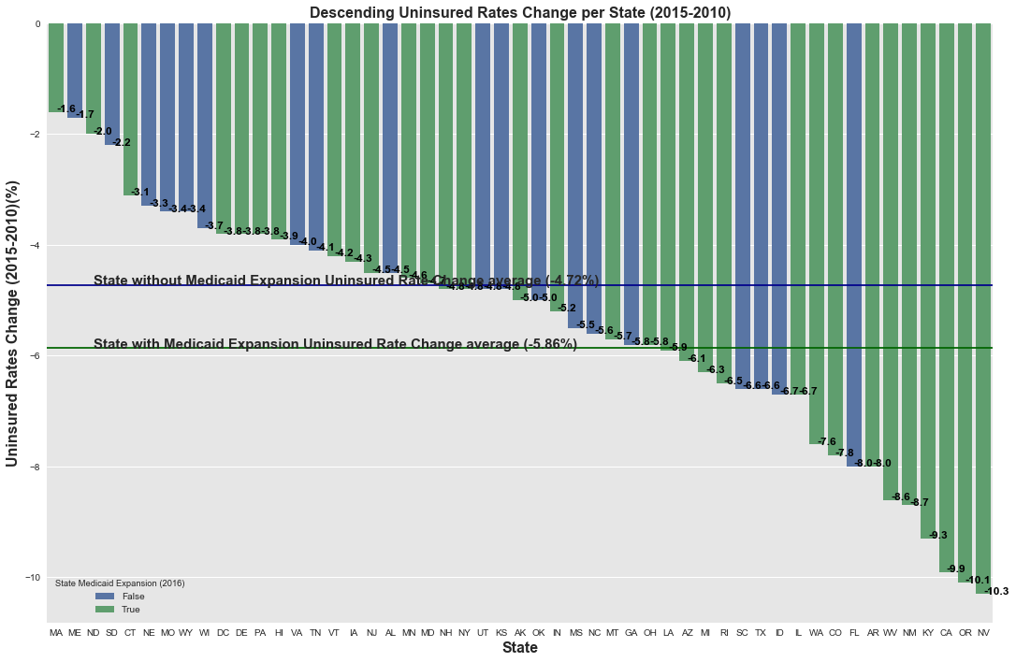
Following the implementation of the PPACA:
All States experienced an increase in medical coverage for their respective populations
Since 2010 to 2015, Health insurance coverage gains were especially strong in Medicaid expansion states
• Non-expansion states had an average uninsured rate change with a drop of 4.72 percentage points.
• Expansion states had an average uninsured rate change with a drop of 5.86 percentage points.

Slide 10
Nevada
Oregon
California
Kentucky
New Mexico
West Virginia
Arkansas
Florida
Colorado
Washington
Left are the first ten states which has the greatest decline of uninsured states from 2010 to 2015.
Florida is the only state which has no Medicaid program coverage expansion.
Massachusetts
Maine
North Dakota
South Dakota
Connecticut
Nebraska
Missouri
Wyoming
Wisconsin
District of Columbia
Left are the last ten states which has the least decline of uninsured states from 2010 to 2015.
There are six out of ten states which have no Medicaid program coverage expansion.

Slide 11
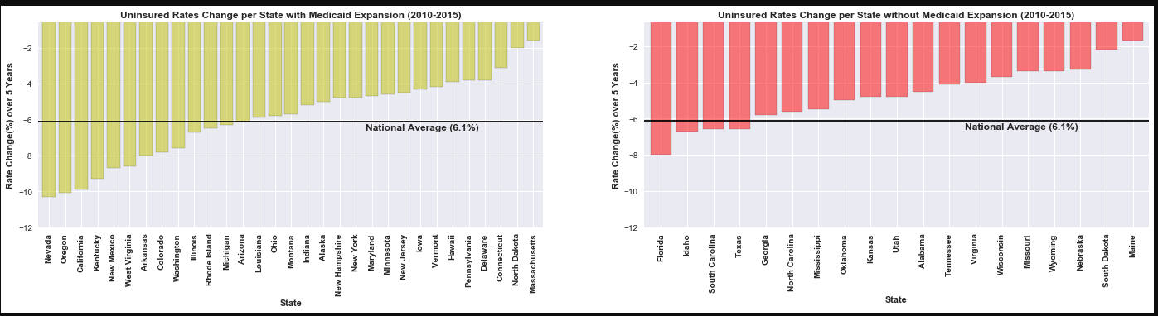
Side by side comparison demonstrating that states that expanded Medicaid had higher drops in Uninsured population Rates. Did the geographic location of the states have an impact on these factors?

Slide 12
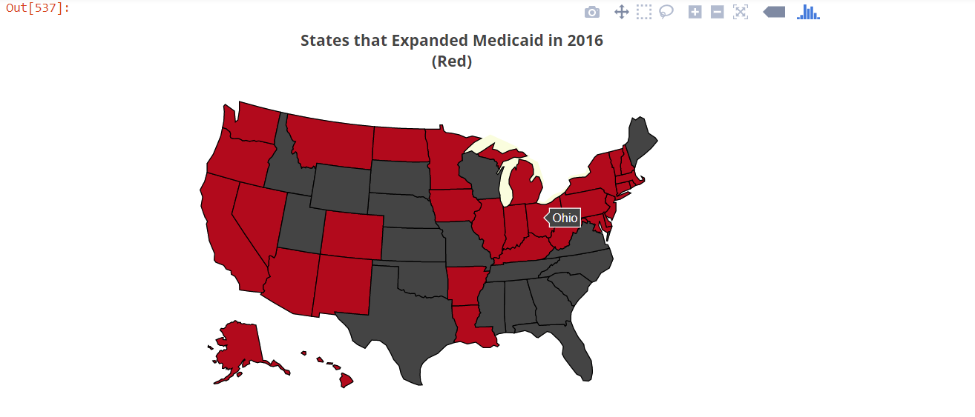
A map visualization of the previous two slides helps to identify where to investigate further correlations:
How would this compare to various voter/political maps
How would this compare to census maps
How would this compare to financial maps with GDP, avg. income, etc

Slide 13
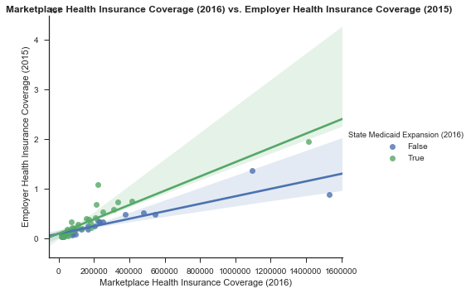
We began to Analyze things in the perspective of Medicaid Expansion versus No Medicaid Expansion:
EmployerHealth Insurance Coverage versus Marketplace Health Insurance Coverage rates were higher in most states that took the Medicaid Expansion.
Should the expansion be considered a stop-gap and not permanent moving forward?

Slide 14
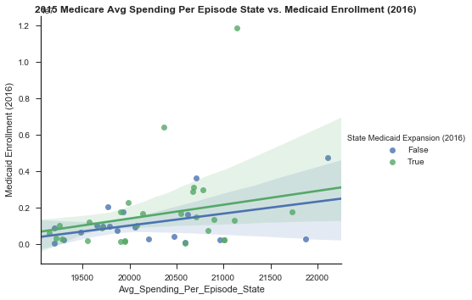
Directly the Average Spending Per State versus Medicare Enrollment had a positive correlation:
Though they were outliers two states that did not expand Medicaid were of the highest in average cost per episode
Another state that did expand Medicaid Coverage and had a significant enrollment in Medicaid did not seem to lower costs as was expected in 2010
Did this state have a reason for this result (underserved populations, sicker populace)?

Slide 15
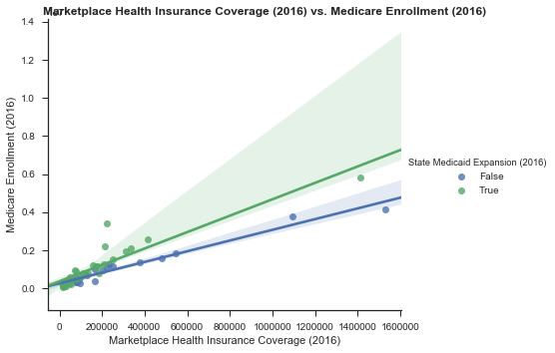
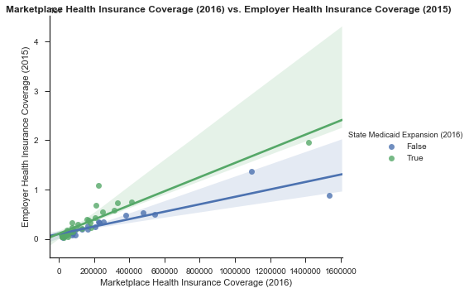
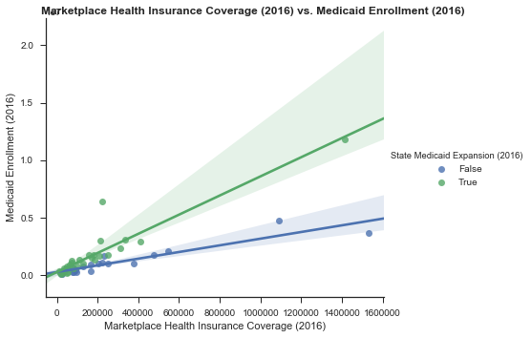
Marketplace Health Insurance Coverage( 2016) has the positive correlation with Medicare and Medicaid Enrollment (2016 )and Employer Health Insurance Coverage (2015) in 50 states.
Medicare, Medicaid and Employer Health insurance coverage gains were especially strong in Medicaid expansion states .

Slide 16
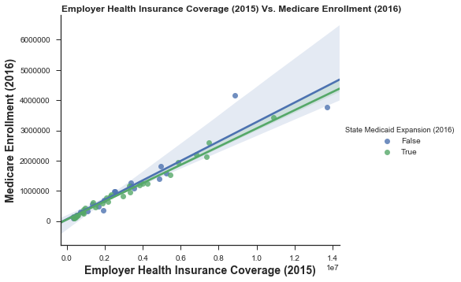
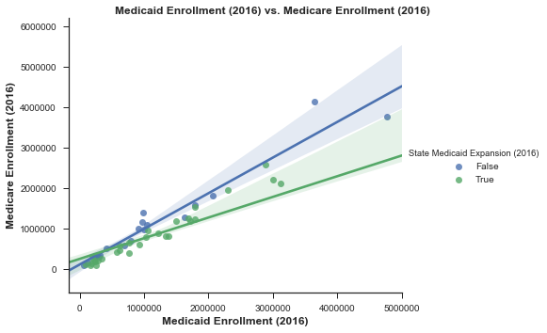

Medicare Health Insurance Coverage( 2016) has the positive correlation with Employer Health Insurance Coverage (2015) and Medicaid Enrollment (2016 )and Marketplace Health Insurance Coverage( 2016) in 50 states.
Medicare coverage gains were especially less in Medicaid expansion states .

Slide 17
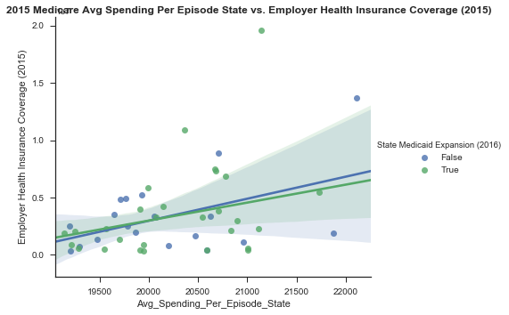
Positive Correlation between a rise in Employee Health Coverage and Average Spending per State:
Was this indicative of anything or was it just congruent with the other side of expanding coverage?

Slide 18
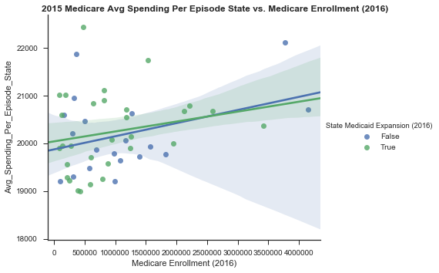
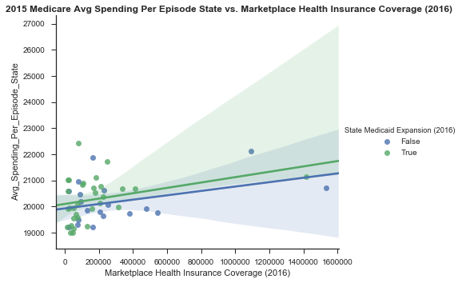
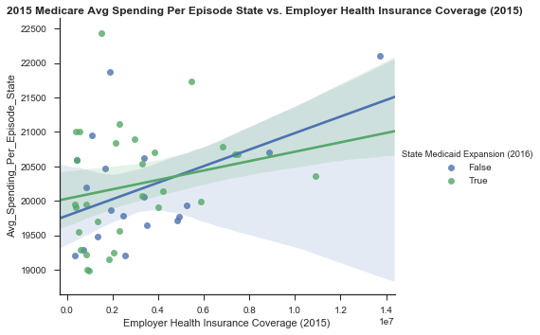
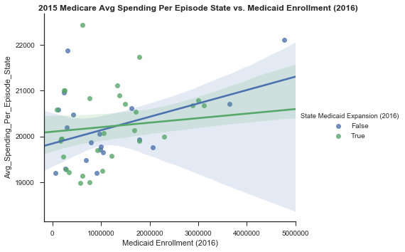

Slide 19
The states' Medicare hospital spending in 2015 increased following the Marketplace Health Insurance, Medicare and Medicaid Enrollment , Employer Health Insurance Enrollment increases in 50 states.
The states' Medicare hospital spending is slightly higher in those states with expanded coverage comparing to the states without expanded coverage.
But for those states with higher Medicaid and Employer Health Insurance Enrollment, the Medicare hospital spending were higher in the states without expanded coverage comparing to the states with expanded coverage. “Studies suggested that rejecting the expansion would cost more than expanding Medicaid due to increased spending on uncompensated emergency care that otherwise would have been partially paid for by Medicaid coverage”[ ].

Slide 20
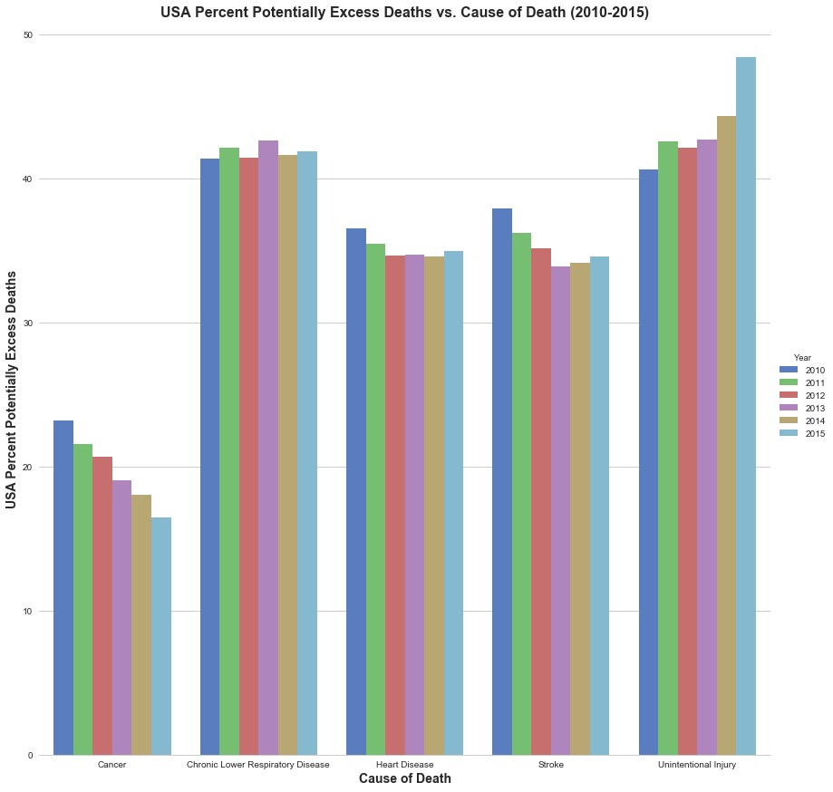
This depicting the death rates from the major killers over the last 5 years. (Cataclysmic events like death are the major cost affecting factors)
Two Interesting Trends Stand Out:
Cancer Death Rates:
Decreased as health care coverage expanded
What further explanations should be investigated?
Unintentional Injury Deaths (Unintentional Poisonings, i.e. overdoses):
Increased as health care coverage expanded
What further explanations should be investigated?
Compared with 2010, the estimated number of Percent Potentially Excess Deaths changed in 2015. Cancer deaths decreased 29% (from 23.2 to 16.5), stroke deaths decreased 9% (from 37.9 to 34.6 ), heart disease deaths decreased 4% (from 36.5 to 34.9), chronic lower respiratory disease (CLRD) (e.g., asthma, bronchitis, and emphysema) deaths increased 1% (from 41.4 to 41.9), and deaths from unintentional injuries increased 16% (from 48.4 to 40.6).

Slide 21
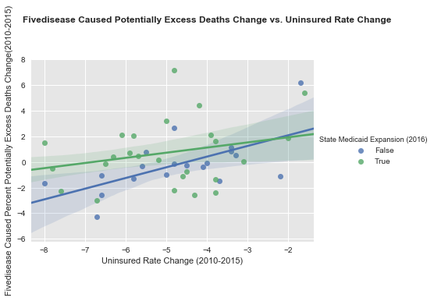
Mortality rates vary widely among states. Uninsured rates also vary widely between 2011 and 2015 in the 50 states.
We find there is a positive trend between Uninsured rates change (2010-2015) and death rate change (2010-2015) in each states in USA. For those states with higher health insurance enrollment increase, their death rates have decreased.

Slide 22
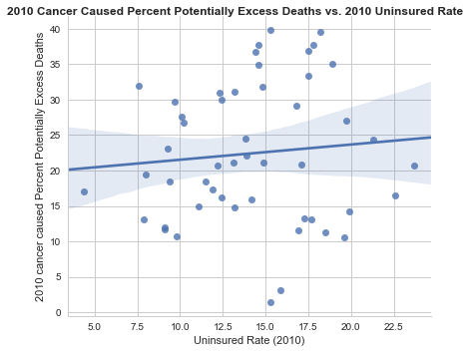
Positive Correlation (slightly)-
There was a slightly positive demonstrable correlation between the states Uninsured Rates in 2010 and the recorded Excess Deaths from Cancer of that year. Though the spread provides a significant amount of outliers

Slide 23
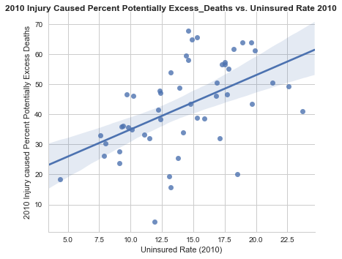
Positive Correlation (more definitive)-
Though there was a more definitive correlation between Injury Caused Excess Deaths versus Uninsured Rates in 2010

Slide 24
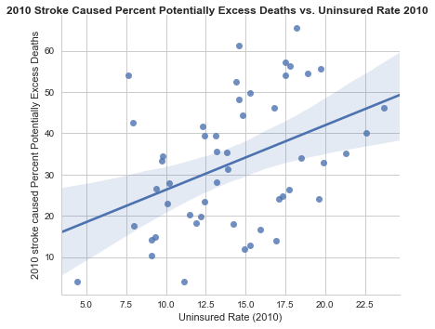
Positive Correlation-
There was also a more significant positive correlation between Excess Deaths via Stroke versus Uninsured Rates in 2010 also

Slide 25
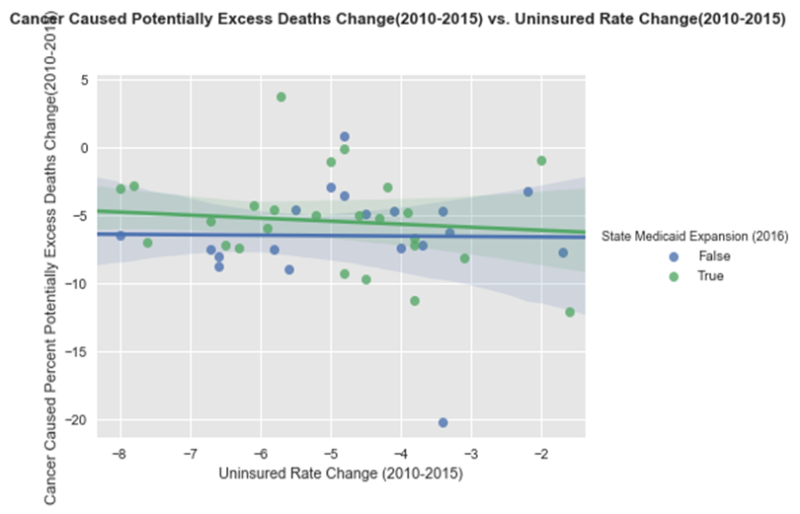
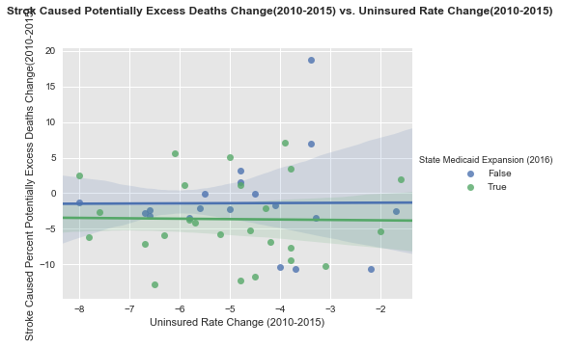
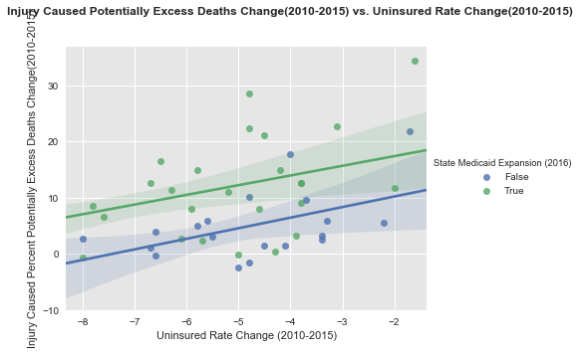
There are no correlation between the Cancer, stroke caused death rate change and uninsured rates change. Stroke caused death rates was lower in those states with Medicaid Expansion.
There are positive correlation between injury caused death rates change and uninsured rates change. For those states with higher health insurance enrollment increase, their death rates have decreased.
Injury caused death rates was higher in those states with Medicaid Expansion.

Slide 26
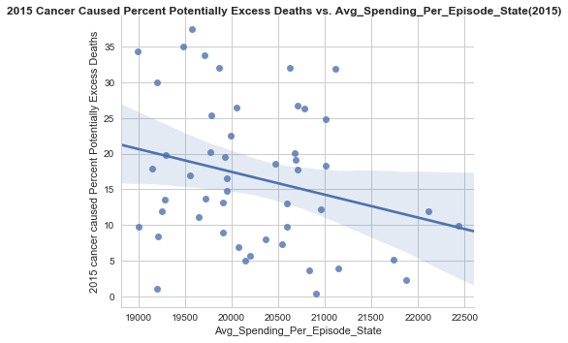
Negative Correlation -
Average Spending Per State had a negative correlation with the recorded Potentially Excess Deaths from Cancer (2015)

Slide 27
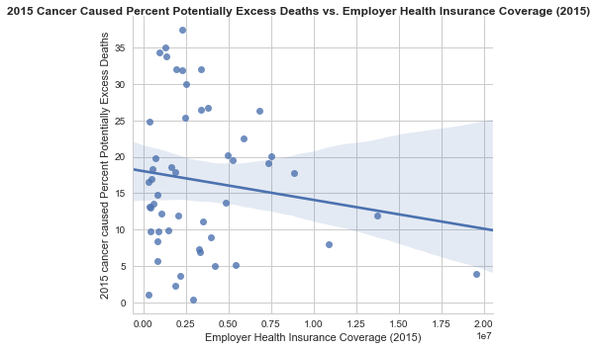
Negative Correlation-
In 2015 the datasets we used showed a slightly negative correlation between Excessive Deaths from Cancer and Employer Health Coverage
Is the coverage provided by employers of lower quality than it was before the PPACA (ie High Deductible Plans)
Is work bad?

Slide 28
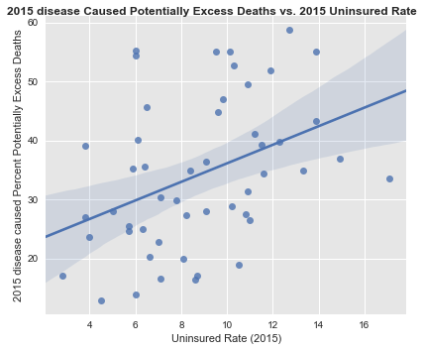
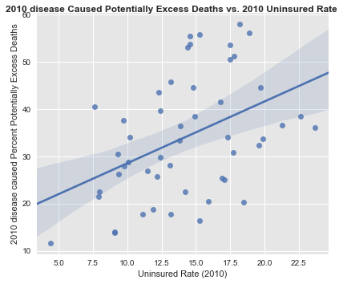
In 2010 and 2015, There are positive correlation between five disease caused death rates and uninsured rates in 50 states.

Slide 29
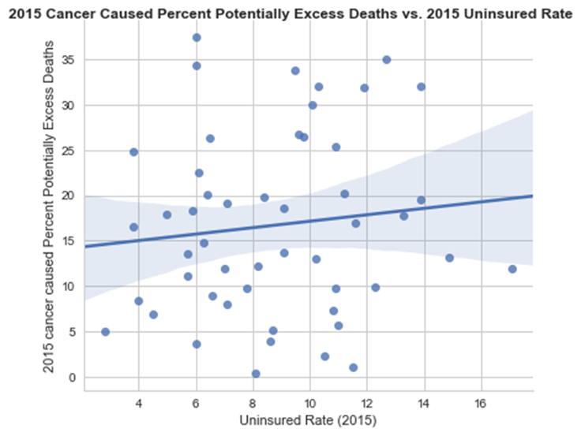
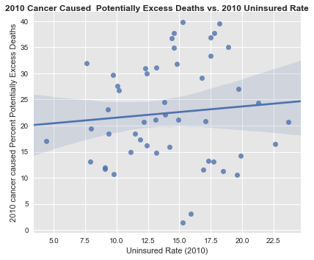
In 2010 and 2015, There are slightly positive correlation between cancer caused death rates and uninsured rates in 50 states.

Slide 30
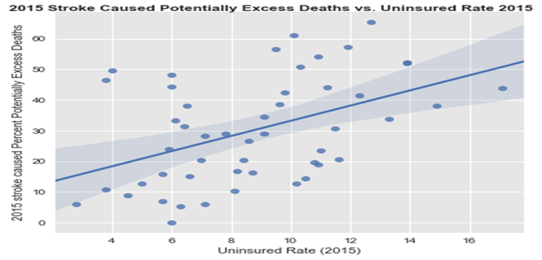
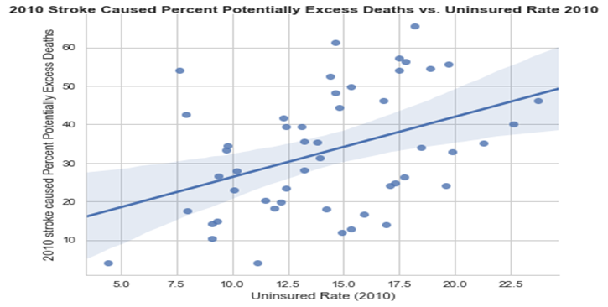
In 2010 and 2015, There are positive correlation between stroke caused death rates and uninsured rates in 50 states.

Slide 31
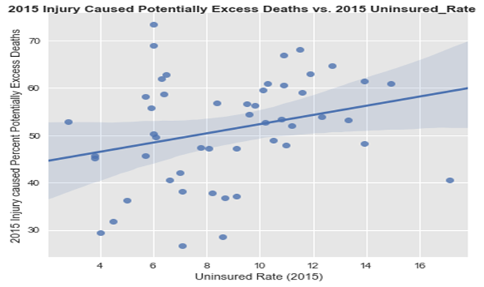
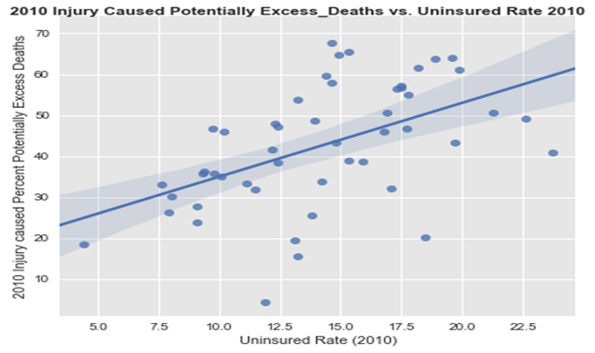
In 2010 and 2015, There are positive correlation between injury caused death rates and uninsured rates in 50 states.

Slide 32
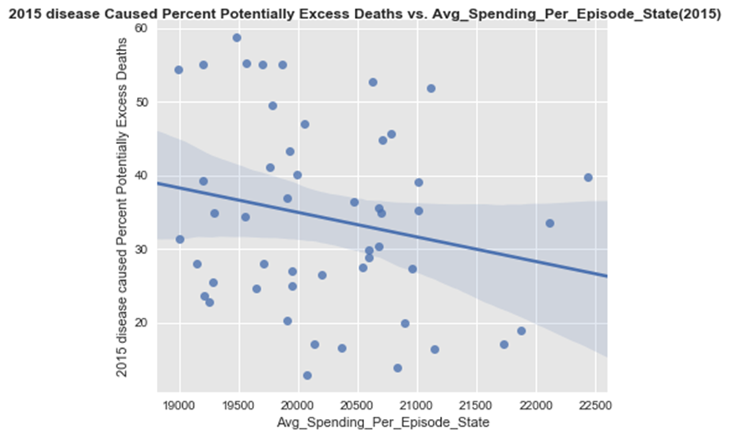
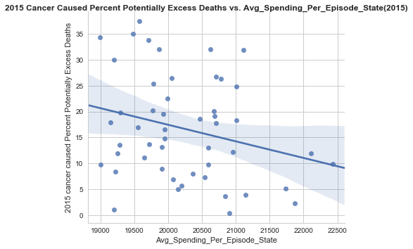
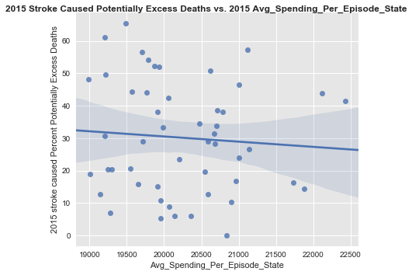
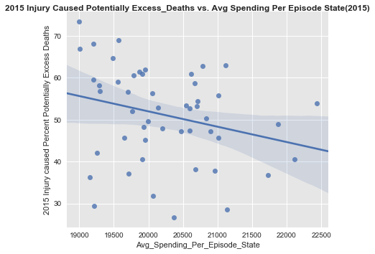
The death rate dropped in every states in the U.S. between 2010 and 2015. A decline of death rate was associated with a significant increase of hospital Medicare spending in all-cause mortality in each state.

Slide 33
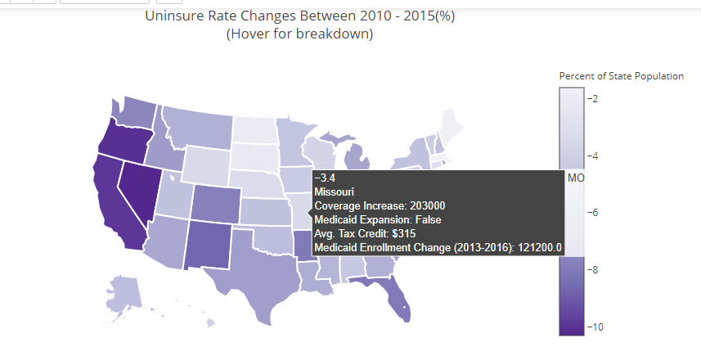
Coverage map depicting Health Insurance Coverage Data Set:
I

Slide 34
Conclusion:
Since 2010 to 2016 , more uninsured people have gained health insurance coverage. Over that period, the uninsured rate dropped from 15.5 percent to 9.4 percent , a 40% reduction in the uninsured rate.
Those states that expanded Medicaid had an average uninsured rate change with a drop of 5.86 percentage points. while those that did not expand Medicaid had an average uninsured rate change with a drop of 4.72 percentage points.
Potentially preventable deaths declined during 2010–2015 for three of the five leading causes of death: diseases of the heart, cancer, and stroke. No change was observed for potentially preventable deaths from CLRD. Potentially preventable deaths from unin­tentional injuries increased each year from 2010 to 2015.
The mortality rate in 50 states declined substantially in the five years after the states increased their health care (including the Affordable Care marketplace health insurance) coverage.

Slide 35
Our project will help with:
Insurance coverage helps save lives, by encouraging early detection and prevention of dangerous medical conditions.* [ ] The analysis of state differences in death rates for the five leading causes of death and their correlations with hospital medical spending and health insurance coverage change could assist state and federal health officials in establishing prevention goals, pri­orities, and strategies.

Slide 36
Limitations:
What we could to do :
1. What contributed the increased coverage of health insurance? An expansion of Medicaid eligibility? or Affordable Care marketplace health insurance?
2. Compare the all kinds of health care hospital cost (not only Medicare hospital spending) to the health insurance coverage in each state.
3. Analysis both the expected and observed number of deaths for each cause and year.
4 . Defining potentially preventable deaths across the five leading causes does not take into consideration the fact that these are complex and diverse causes of death. In addition, the majority of risk factors do not occur randomly in populations; they are closely related to the social, demographic, environmental, economic, and geographic attributes of the neighborhoods in which per­sons live and work.

Slide 37
Reference:
https://en.wikipedia.org/wiki/Patient_Protection_and_Affordable_Care_Act
https://www.cdc.gov/media/releases/2014/p0501-preventable-deaths.html
https://www.cdc.gov/mmwr/volumes/65/wr/mm6545a1.htm--Potentially Preventable Deaths Among the Five Leading Causes of Death — United States, 2010 and 2014

Slide 38

Thank you!
Leo, Rowan and Angelo

